Slide 1

Microsoft Teams MS-700
Set Custom Streaming Policy in Microsoft Teams

Slide 2
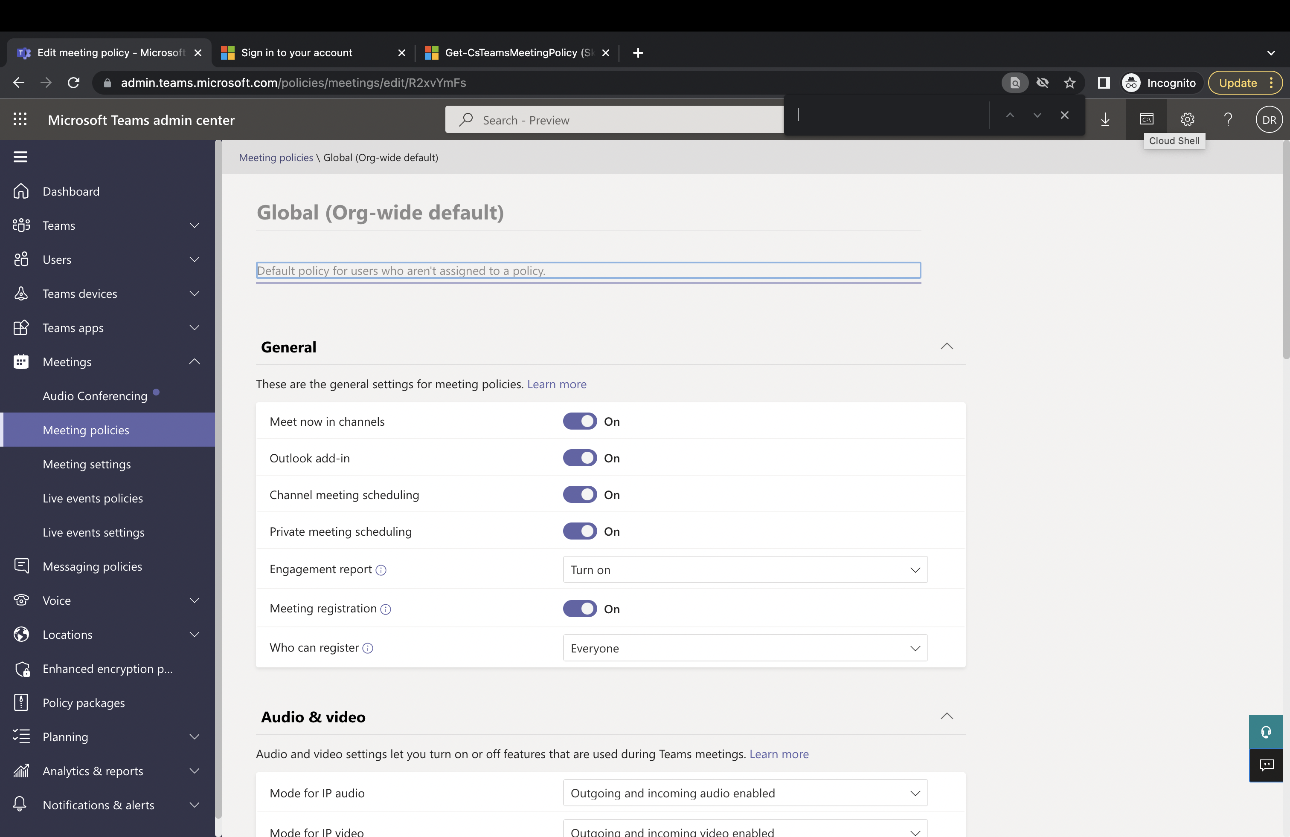
Upper Right – Click on Cloud Shell

Slide 3
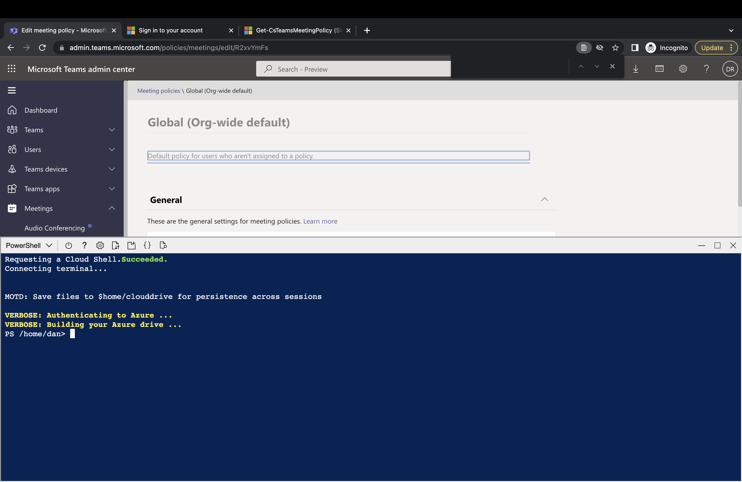
Then Three Commands

Slide 4
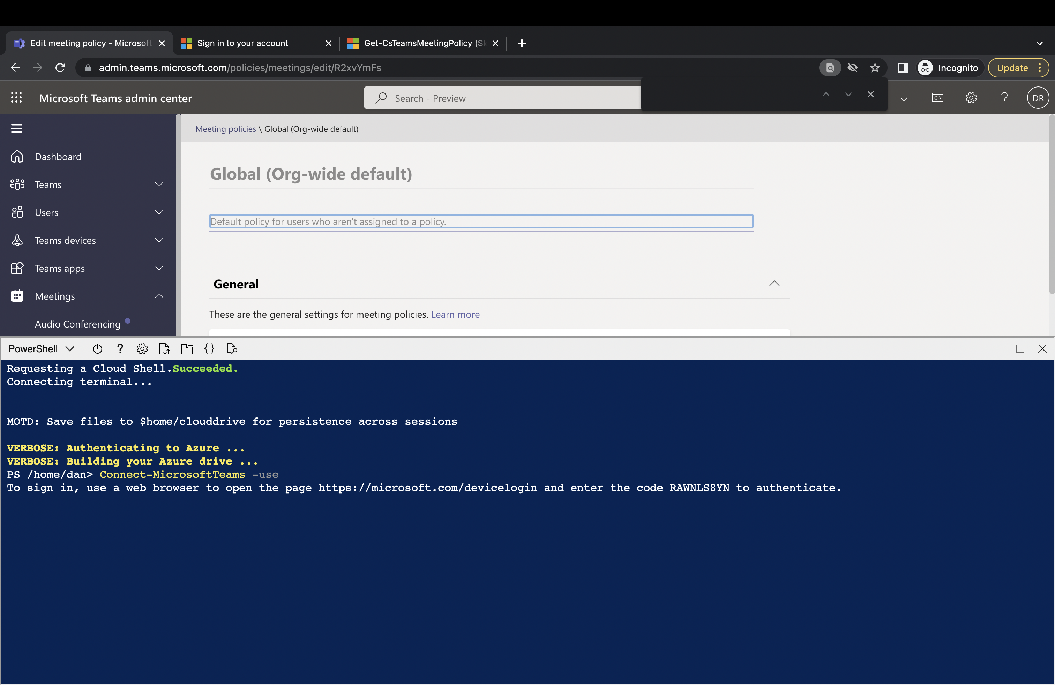
In the Cloud Shell (PowerShell) Window:
Connect-MicrosoftTeams -use

Slide 5
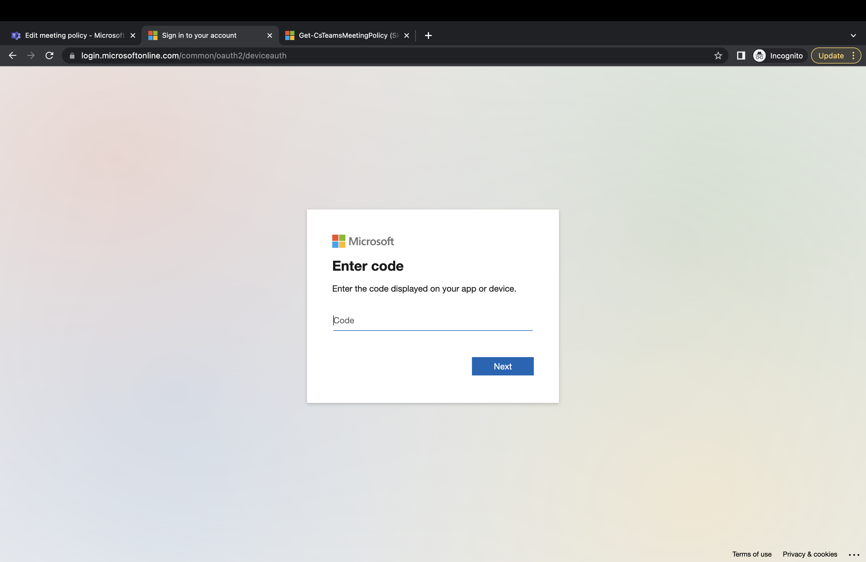

Slide 6
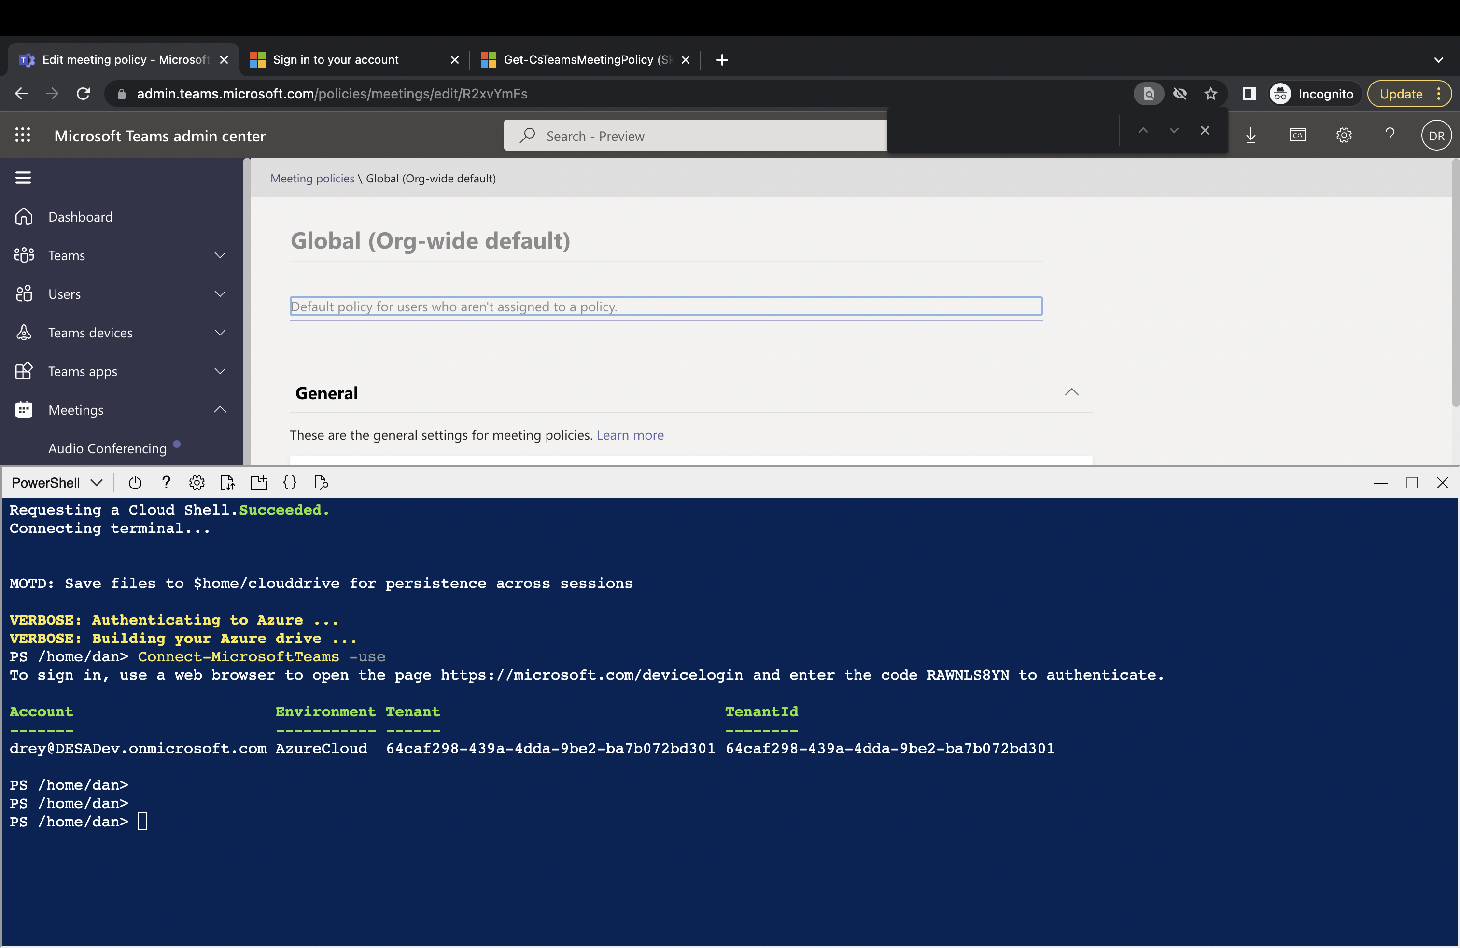
This is the output

Slide 7
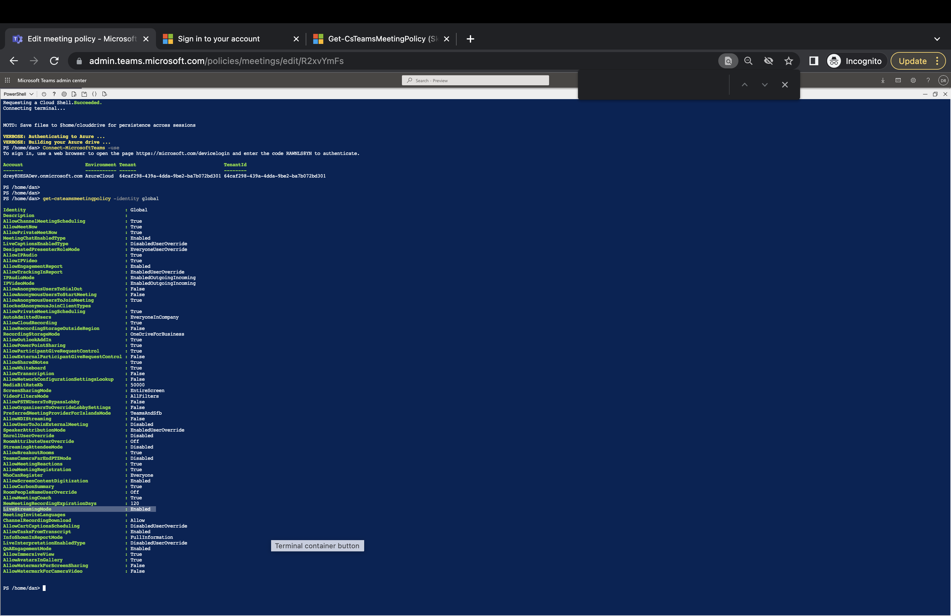
Get-CSTeamsMeetingPolicy

Slide 8
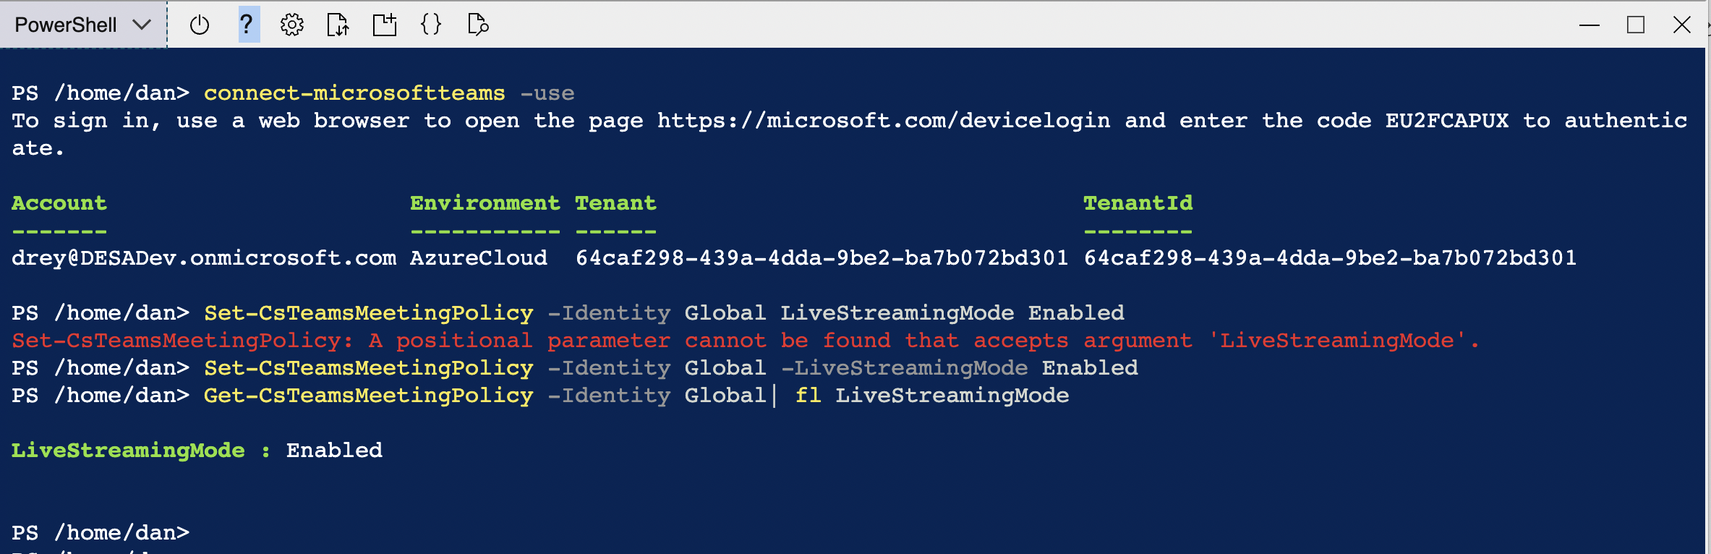
CloudShell to execute PowerShell from the Teams Admin Center

Slide 9
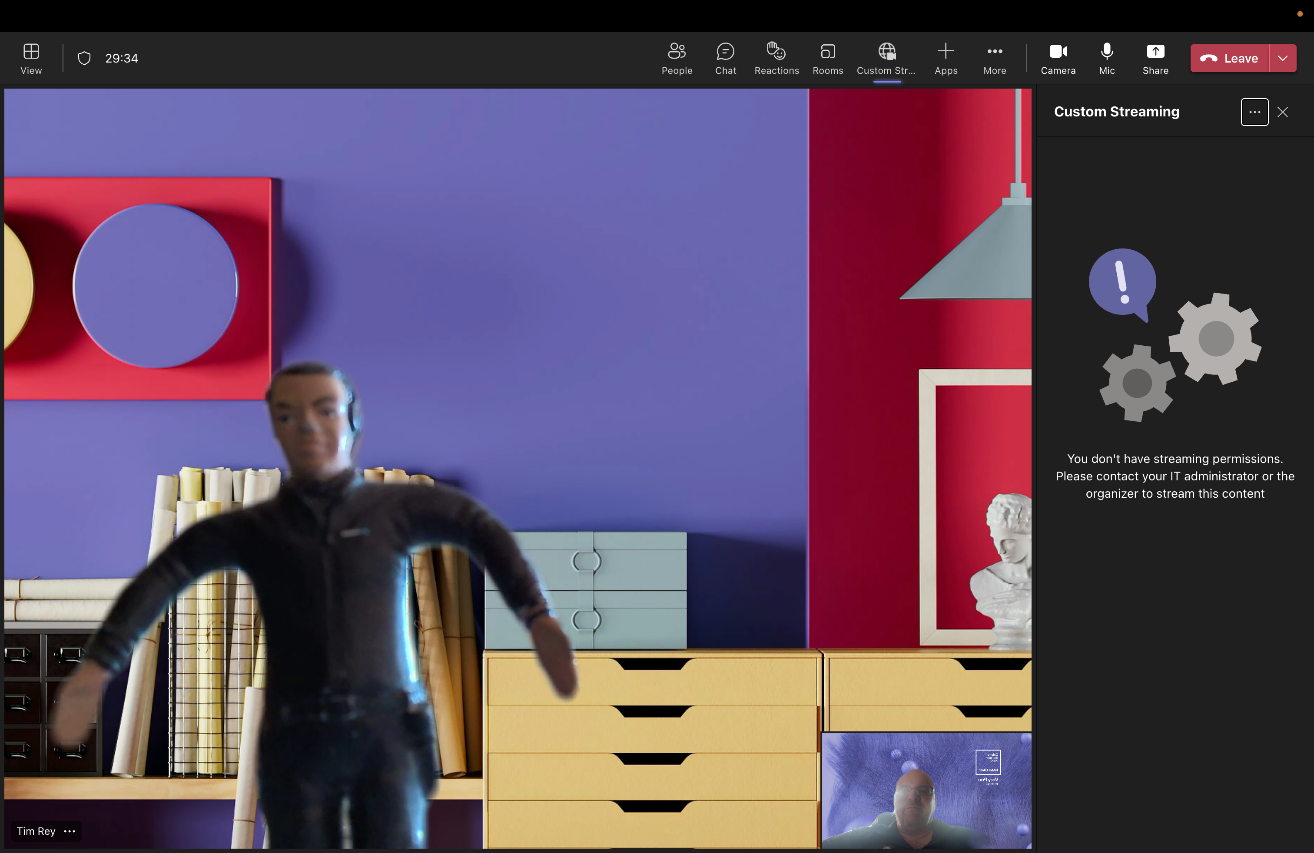
Add App – Custom Streaming to a Meeting

Slide 10
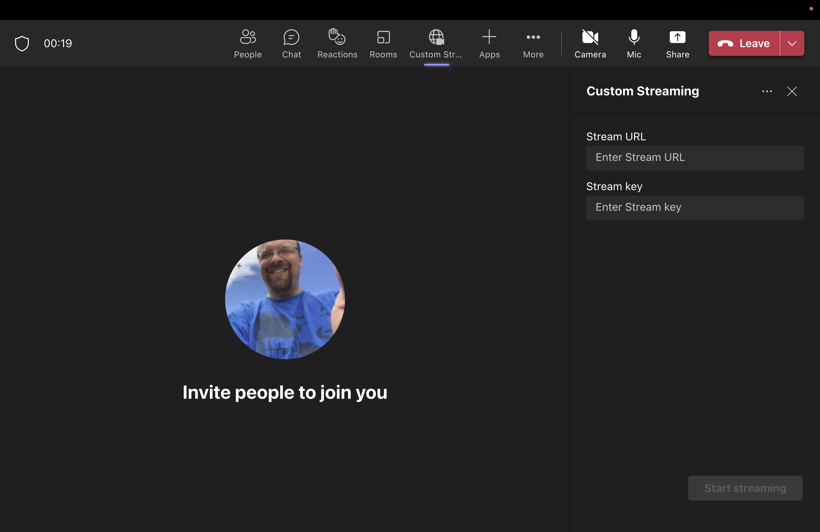
This is what it looks like once setting is enabled

